Slide 1
Design & 3D Printing of Rhinoplasty Surgical Guide for Nasal Hump Reduction
Aravind Ramachandran & Rishi Chauhan (A0263484X)

Slide 2
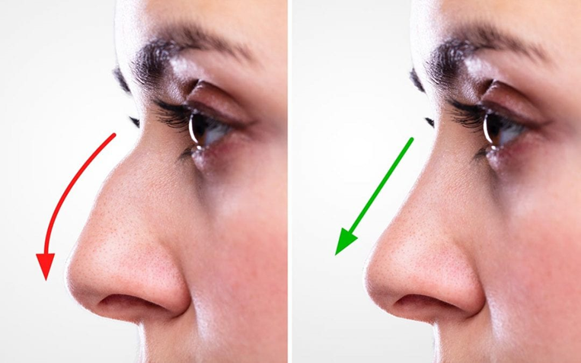
Plastic Surgery of The Nose: Rhinoplasty
Reconstruction, correction or complete change in the shape of the nose.
Colloquially referred to as a nose job.
Done for multiple reasons:
To free up blocked airways that often hamper sleep and restrict proper breathing.
In case of severe trauma to the nose.
Cosmetic purposes.

Slide 3
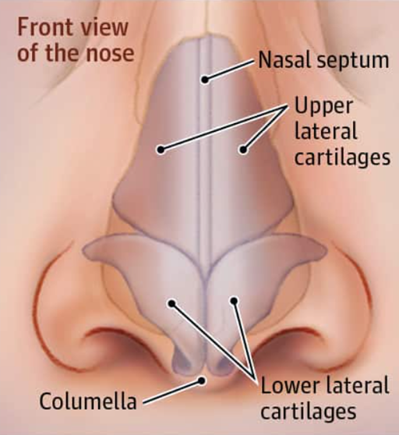
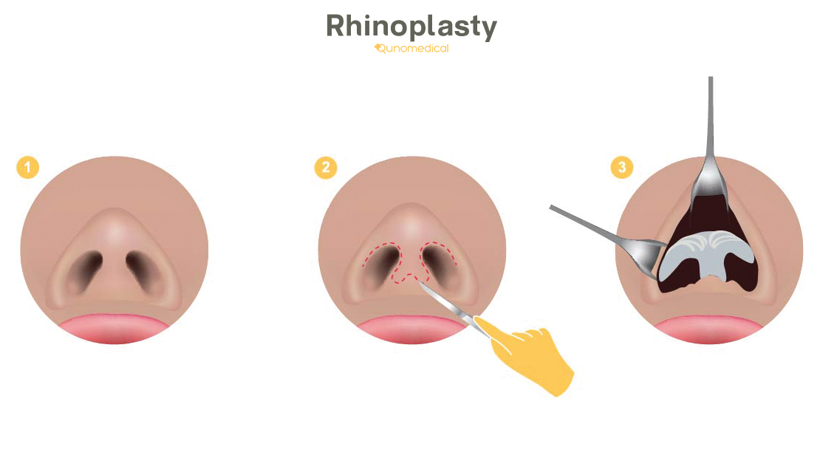
Process of Rhinoplasty

Slide 4
Types of Rhinoplasty
Open (External)
Closed (Endonasal)
Incisions made externally under the nose tip
Incisions are visible externally
Performed for more cosmetic surgeries
The entire nose is accessible to the surgeon as nose can be flapped up
Minimal incisions are made inside the nose.
Incisions not visible externally and are very small.
Peformed when minor changes in the nose tissue are desired and minor bridge changes.
Surgeons have less access to the complete nose.

Slide 5
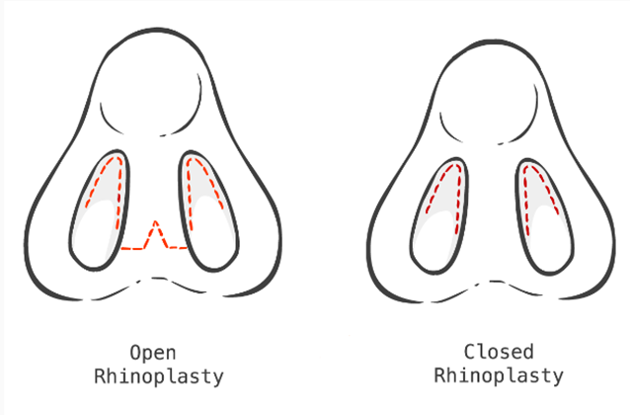

Slide 6
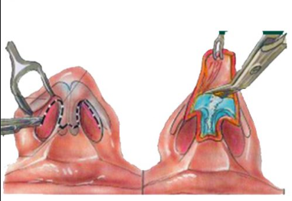
Open Rhinoplasty
Advantages
Disadvantages
Surgeon gets better access and visualization of the nose enabling complex topological surgeries.
Grafting of a good chunk of the tissue is possible.
Lots of scars are formed that are visible externally requiring a cast to protect.
Increased recovery time due to swelling and excessive scarring.

Slide 7
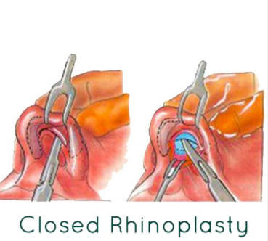
Closed Rhinoplasty
Advantages
Disadvantages
Minimal and non-visible scarring.
Reduced recovery time as swelling, and scarring is lower.
Operation time is reduced.
The surgeon has difficulty operating the complex topography
Major changes to the nose are difficult to be done using this technique as access to tissues is limited.
Only minor grafts for the nose tip are possible.

Slide 8
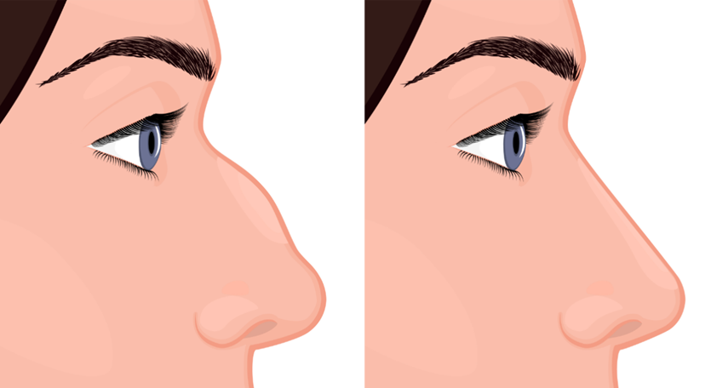
Nasal (Dorsal) Hump Removal
Hump is a major factor in aesthetic as well as functional attributes of a nose
The most common rhinoplasty is to change the hump
Hump has a complex 3-dimensional topography
Requires expertise and experience
Done in both open and closed type

Slide 9
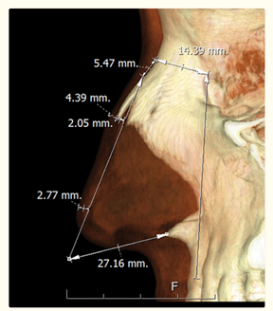
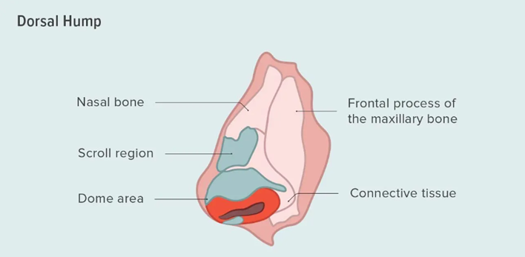
Nasal Hump Removal Process

Slide 10
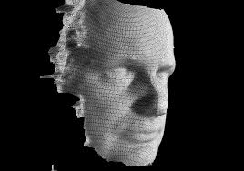
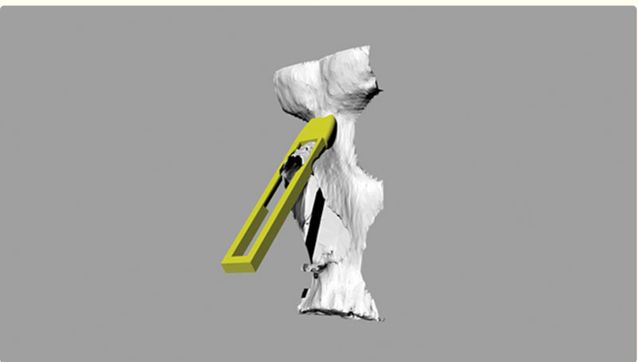
Surgical Guides Current Technology

Slide 11
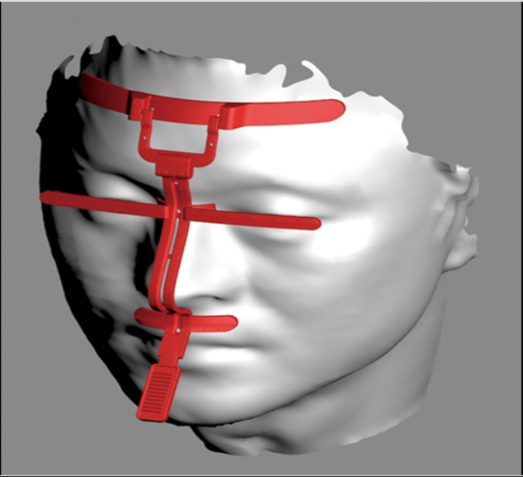
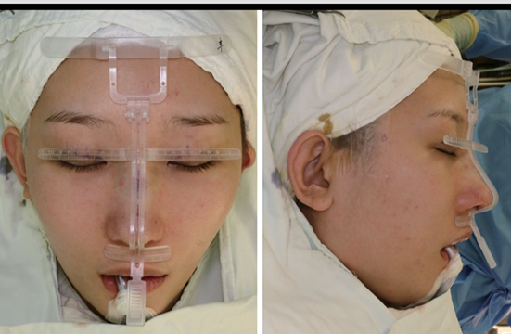
Surgical Guide II

Slide 12
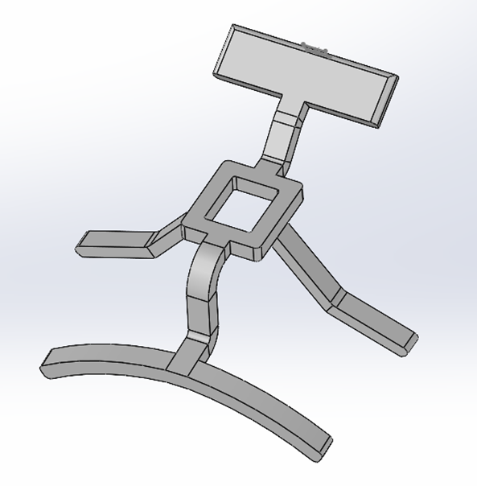
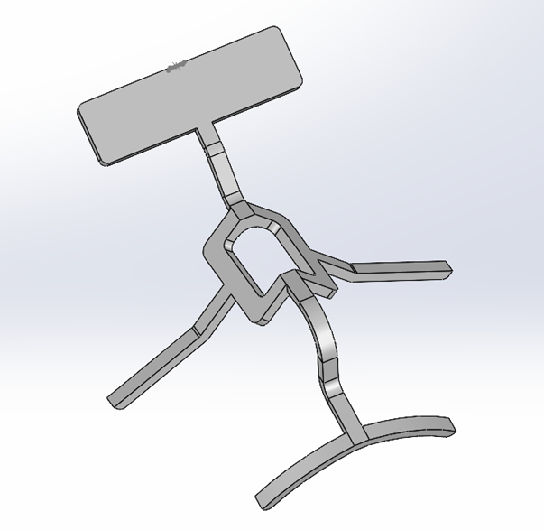
Design Procedure
Designed using SolidWorks
Two types
Type 2
Type 1

Slide 13
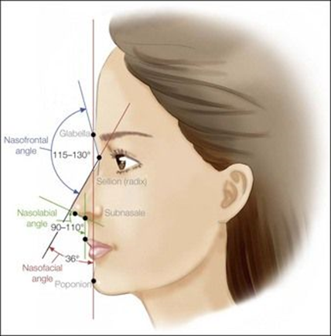
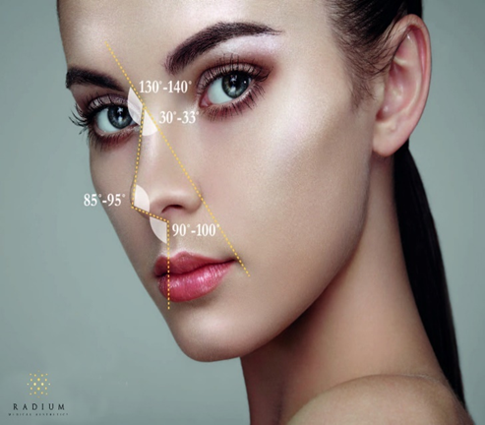
Nasal Dimensions

Slide 14
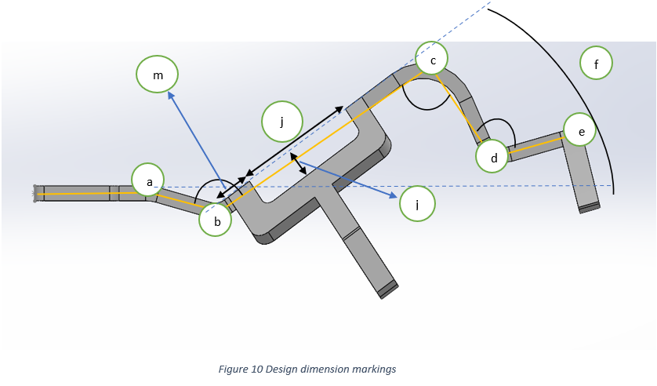
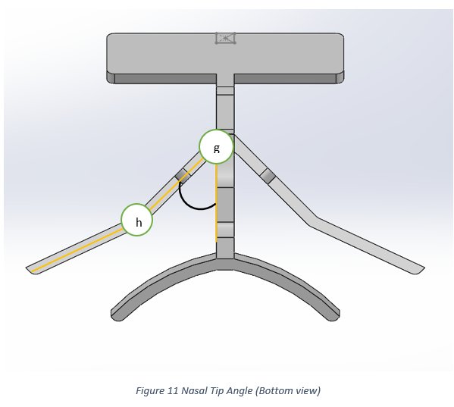
Dimension Markings
Simple representations for marking the dimensions and angles

Slide 15
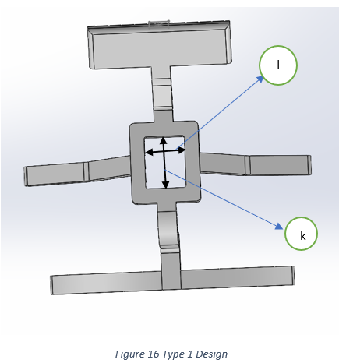
Dimension Terminologies
Angle subtended at:
'b' - Nasofrontal ,
'c' - Nose Tip Angle
'd' - Nasolabial Angle
'f' - Nasofacial Angle
'g' - Nasal Tip Angle (Half)
Rest of the distance dimensions are represented as 'a_b', 'b_c', 'c_d', 'd_e'…...
'm' - Hump location , 'i' - Hump Depth, 'j' - Hump Length (Type 2)
'l' - Hump Width, 'k' - Hump Length (Type 1)

Slide 16
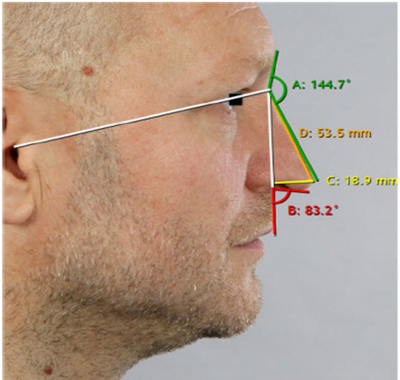
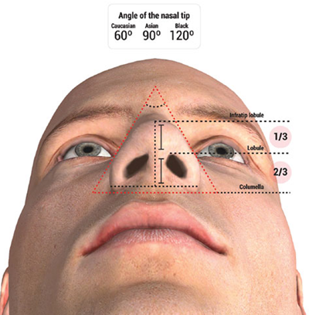
3D Photographic Simulation
Method employed to obtain the dimensions of the actual nose

Slide 17
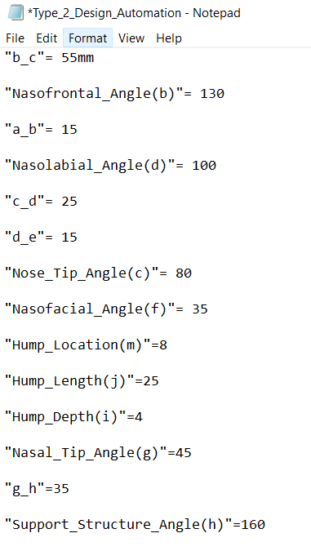
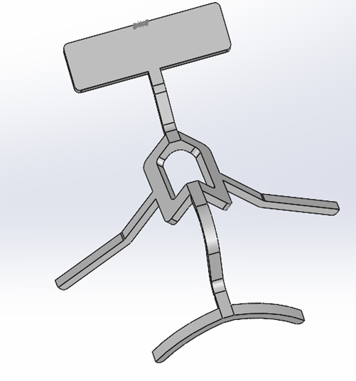
Design Automation
Semi Automated Workflow

Slide 18
3D Printing Process
FDM
Polyjet
A thermoplastic material (in solid form) is melted via a hot nozzle and deposited layer by layer to build the desired object.
Relatively lower cost
Generally, can print using only one material/color (unless the machine accepts multiple spools) at a time.
Photopolymer droplets (in liquid form) are dropped onto a platform using multiple jets and solidified using UV light. The object is also built layer by layer
Relatively higher cost
Can print multiple materials and colors at the same time.

Slide 19
3D Printing Process
FDM
Polyjet
Surface finish and dimensional accuracy is relatively low due to the poor resolution of the layer height.
Material choice is restricted to a few thermoplastic materials such as ABS, PLA etc.
The product is stronger and more rigid and can also be made thermally resistant. However, the dimensional accuracy suffers.
Requires fewer supports as the object is more rigid whilst printing. However, the support removal process in manual and can be tedious.
Surface finish and dimensional accuracy are very good due to a fine resolution of layer height as well as small droplet size being available.
Material choice is extremely vast ranging from polymers, dental printing materials, rubber like materials etc.
The product is often not as strong as the FDM counter part however the geometric accuracy is excellent.
Requires more supports as the object is built using liquid droplets that are later solidified. However, the support can be printed in a different material that allows for it to be dissolved away in post processing.

Slide 20
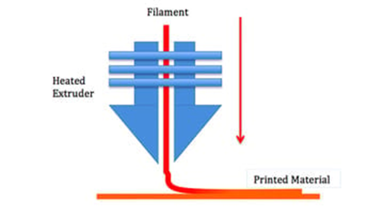
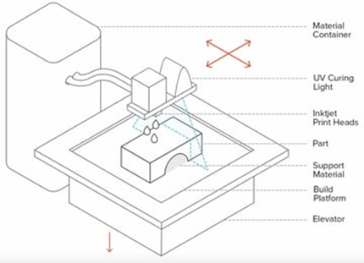
3D Printing Process
FDM
Polyjet

Slide 21
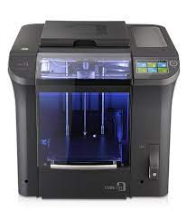
Printing Parameter FDM
Layer Height:
Prototype 1: 0.3mm
Prototype 2: 0.15mm
Printing Time:
Prototype 1: 3 Hours
Prototype 2: 6 Hours
Total Cost: SGD 40
Cubicon 3DP 310F
Material : PLA
Build Volume: 240x190x200 mm
Best Layer Resolution: 0.1mm

Slide 22
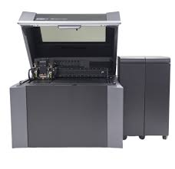
Printing Parameter PolyJet
Layer Height:
Prototype 3: 0.03mm
Printing Time:
Prototype 3: 7 Hours
Total Cost: SGD 340
Stratasys J750
Material – Vero (Magenta)
Build Volume: 490x390x200 mm
Best Layer Resolution: 0.014 mm

Slide 23
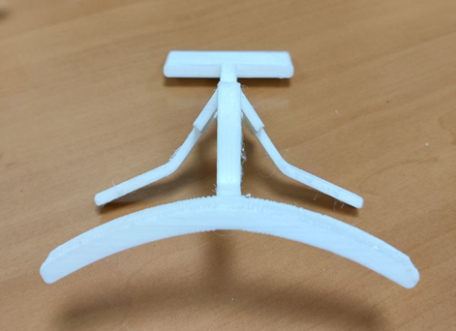
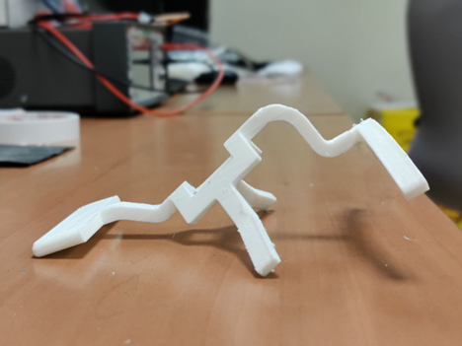
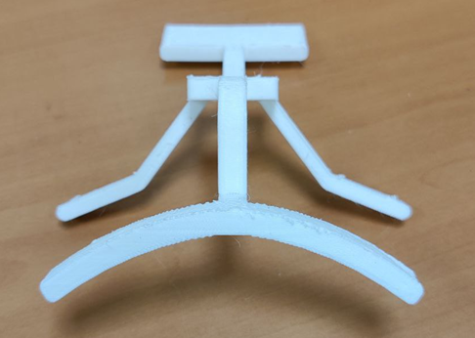
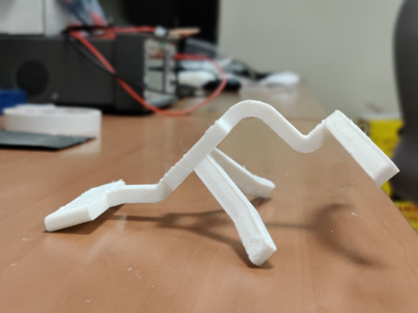
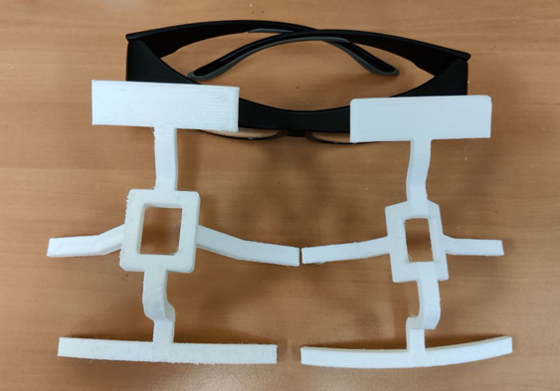
Results
3D Printed Parts (FDM) - PLA
Manual Post processing required
Surface finish better for 0.15mm Type 2
Low Cost
Type 1

Slide 24
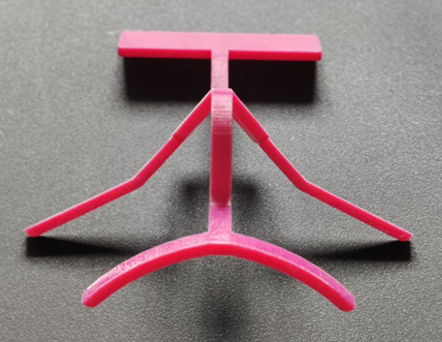
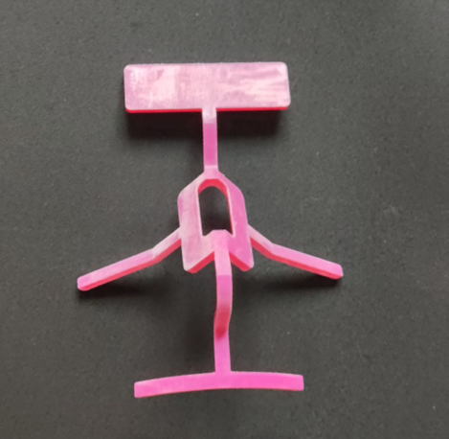
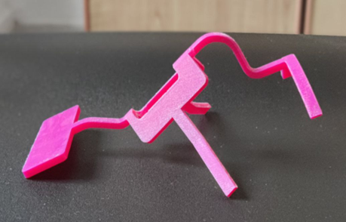
Contd.
PolyJet Print
Better Surface Quality
Expensive
Dimensional Accuracy High

Slide 25
Conclusion and Future Works
3D Printing – Patient Specific, Complex design
Future Works:
Disassembled structure
Fully Automated Workflow
Design enhancement for nasal deviation and nasal tip correction
Printing with other 3D Printing technologies like SLS, SLA etc.

Slide 26
THANK YOU!

